Slide 1

Team Details
Team Name: Anjroid
Team Leader Name: Achhuta Nand Jha
Problem Statement: Potato Disease Classification

Slide 2
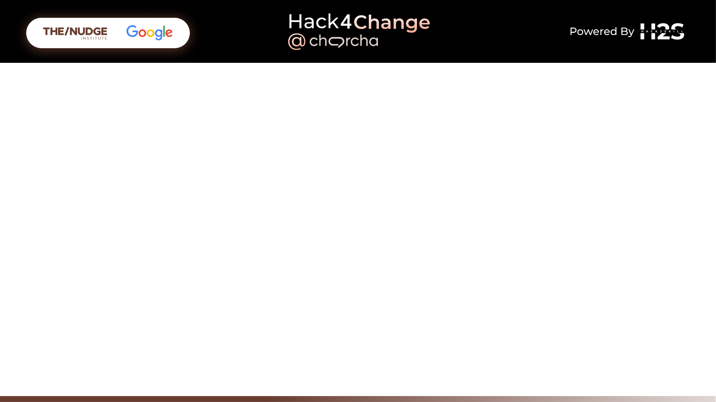
The Potato Disease Classification project aims to develop a machine learning model capable of accurately identifying various diseases affecting potato plants based on images of their leaves. This project leverages computer vision techniques and deep learning algorithms to diagnose common potato diseases, helping farmers and agricultural professionals take timely and appropriate action to manage and treat these diseases.

Slide 3
Global Reach: Usable by potato farmers worldwide, addressing a common agricultural
issue.
Market Expansion: Adaptable for other crops, opening new agricultural sectors.
Collaborations: Partnerships with agricultural institutes for enhanced accuracy.
Support Potential: Opportunity for government and NGO backing, especially in
developing regions.
IoT Integration: Potential for integration with agricultural IoT devices for real-time
monitoring.
Opportunities:

Slide 4
Advanced AI Techniques: High accuracy with deep learning and transfer learning
models.
User-Friendly: Designed for non-technical users with a simple,
smartphone-accessible interface.
Real-Time Diagnosis: Instant disease identification, unlike many existing solutions.
Comprehensive Database: Continuously updated dataset for accuracy and relevance.
How different is it from any of the other existing ideas?

Slide 5
Accurate Detection: Identifies diseases early, reducing crop loss and improving yield.
Resource Optimization: Helps in precise pesticide use, cutting costs and
environmental impact.
Farmer Empowerment: Reliable tool for effective crop management without expert
dependency.
Educational Resource: Provides knowledge about diseases and management
practices.
How will it be able to solve the problem?

Slide 6
High Accuracy: Advanced AI ensures reliable disease detection.
Ease of Use: Simple interface accessible to non-technical users.
Real-Time and Automated: Instant diagnosis and recommendations with automated
workflow.
Scalability: Can handle large user volumes and adapt to other crops.
Sustainability Focus: Promotes optimal resource use and reduces pesticide
dependency.
Community Support: Facilitates data sharing and collective knowledge among farmers.
USP of the proposed solution

Slide 7
High Accuracy: Advanced deep learning models ensure precise disease detection.
Real-Time Diagnosis: Instant results upon image upload.
User-Friendly Interface: Accessible via smartphones and computers, designed for
non-technical users.
Comprehensive Database: Covers a wide range of potato diseases.
Automated Workflow: Fully automated from image upload to diagnosis and treatment
recommendation.
Resource Optimization: Recommends specific treatments to minimize pesticide use.
Scalability: Handles large data volumes and user interactions efficiently.
List of features offered by the solution

Slide 8
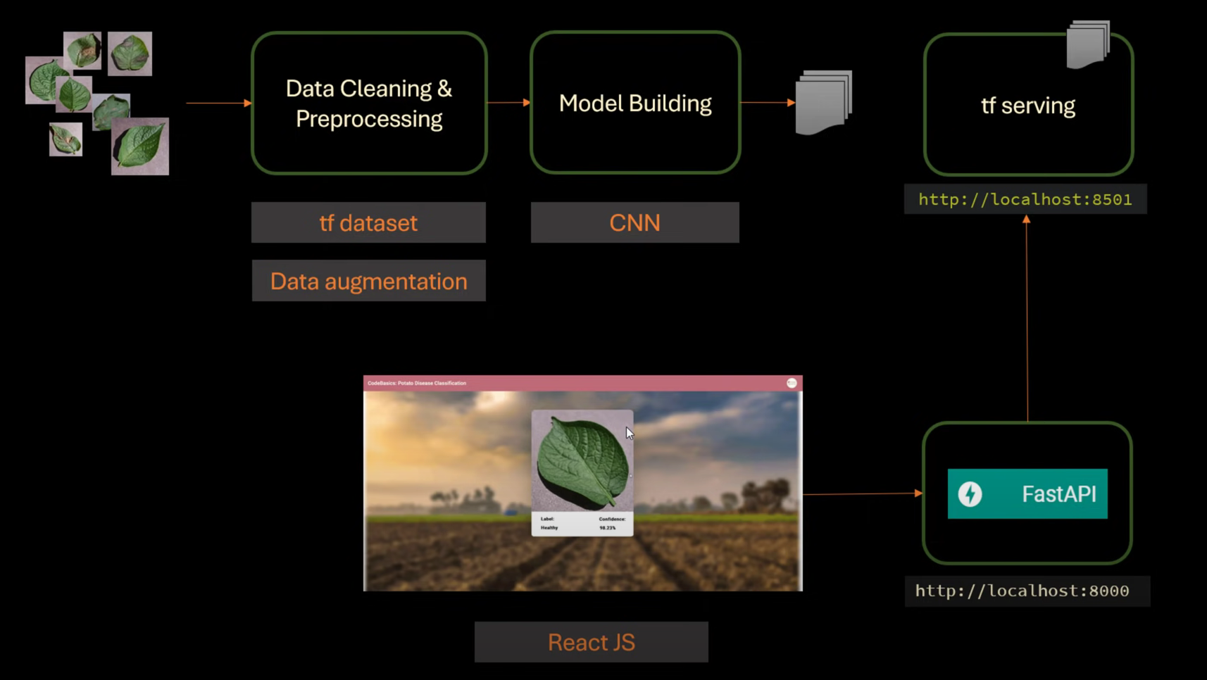
Process flow diagram or Use-case diagram

Slide 9
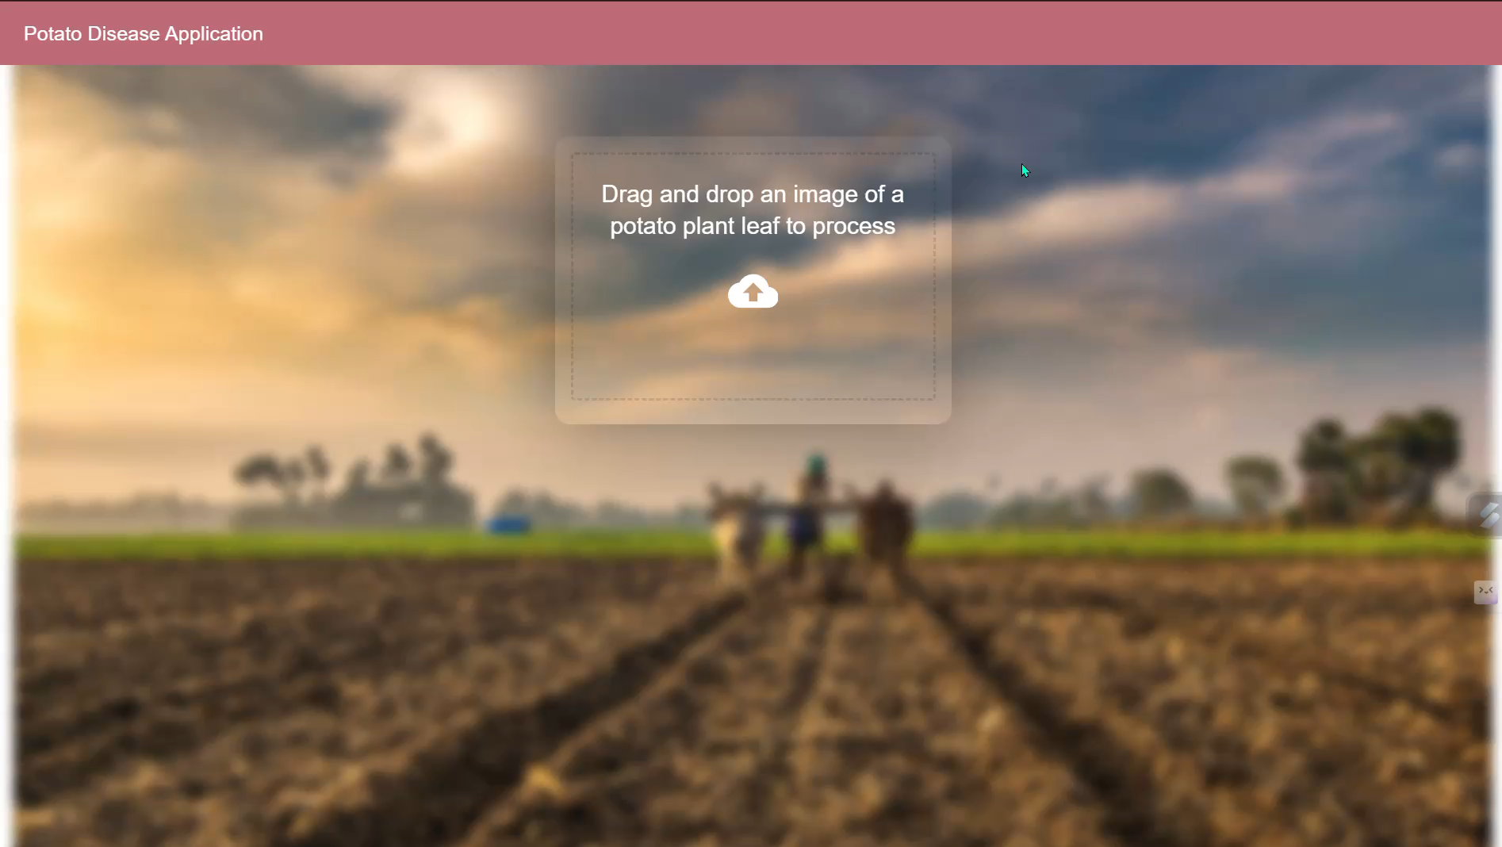
Architecture diagram of the proposed solution

Slide 10
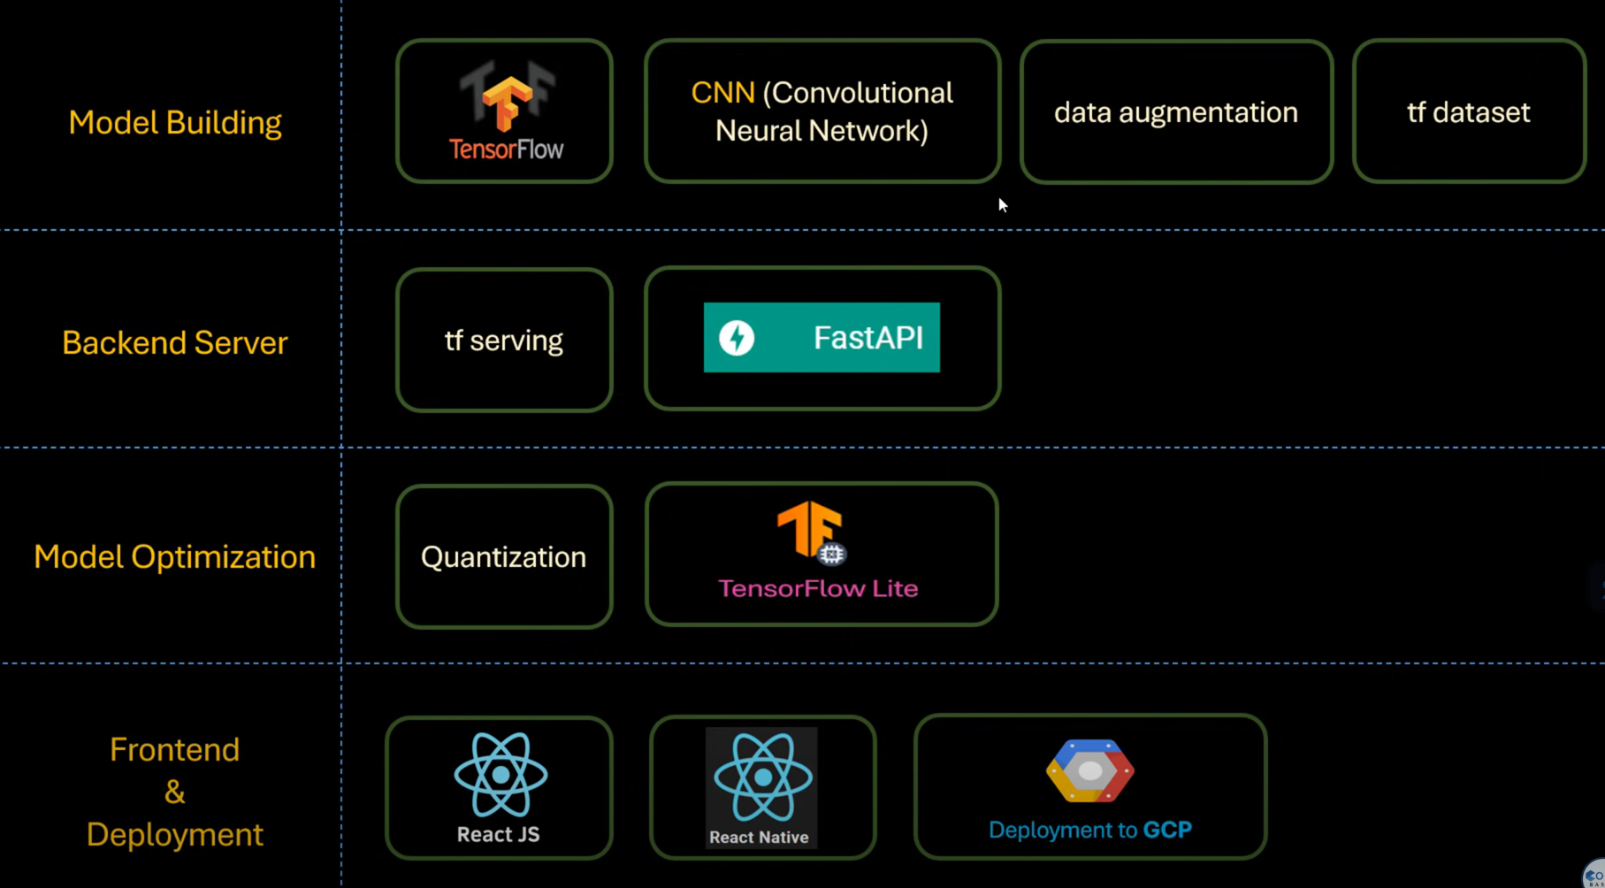
Technologies to be used in the solution:

Slide 11
GITHUB REPO: https://github.com/ArjunRajputGLA/Potato_Disease_Classification

Slide 12


